Slide 1

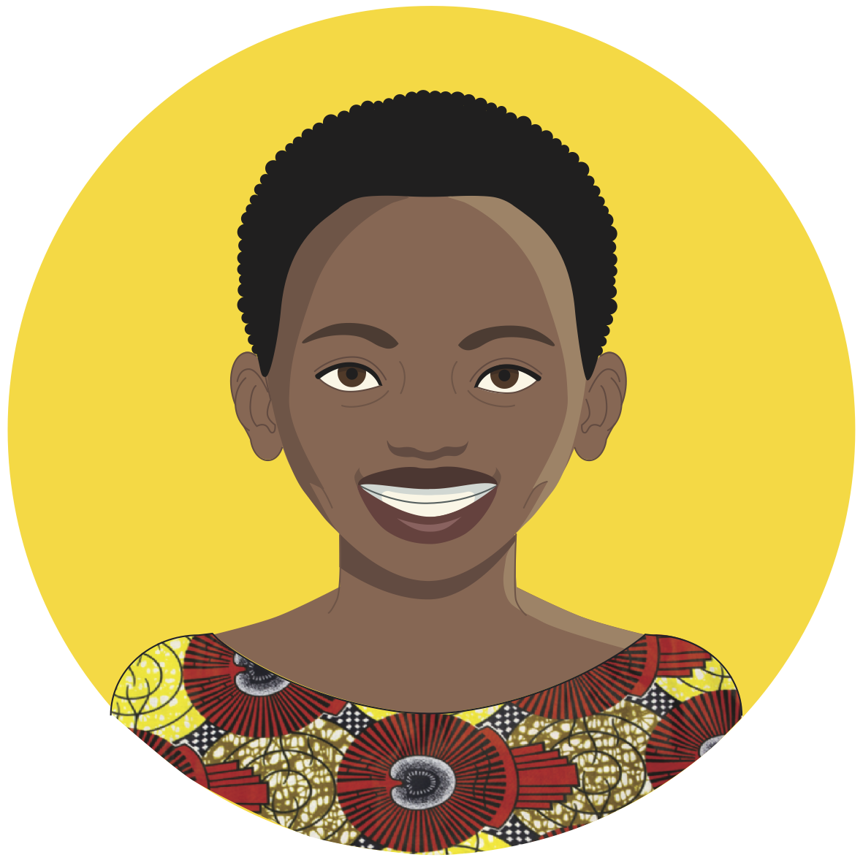
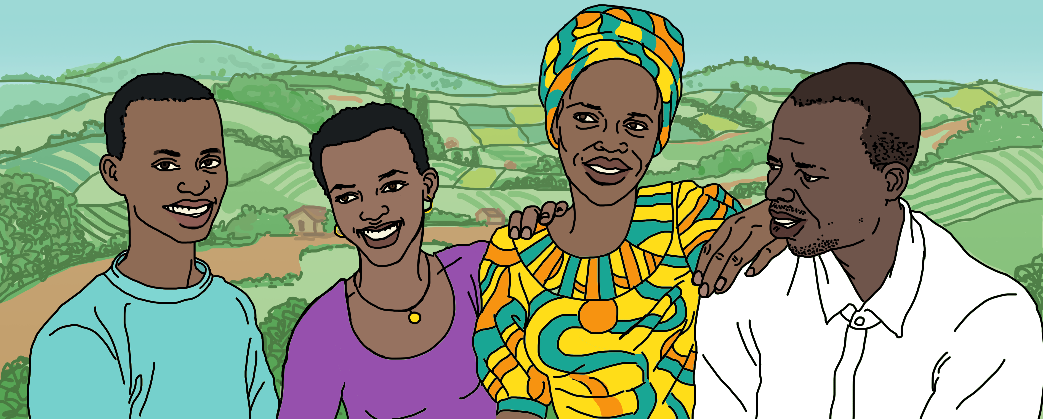
“IrindeBot”
A Chatbot for Adolescent Sexual and Reproductive Health and Rights (ASRHR) in Rwanda

Slide 2
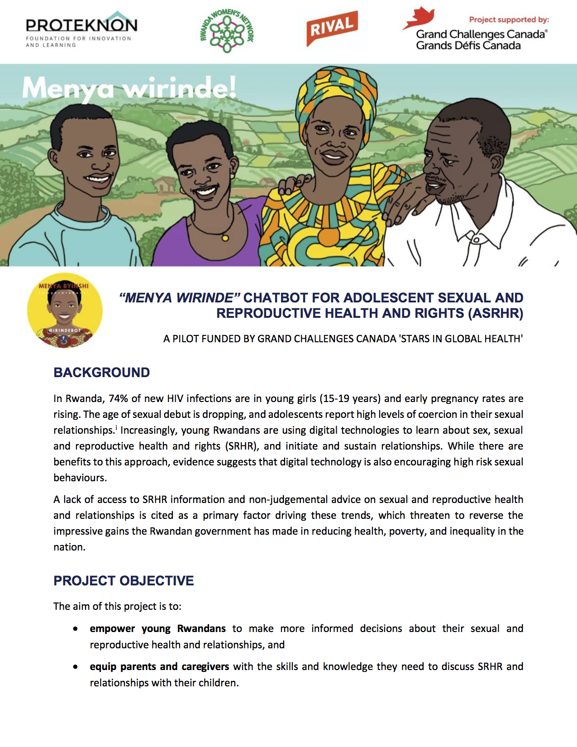
The “Menya Wirinde!” Pilot Project
“Menya wirinde” - “Learn so that you can protect yourself”.
It is in this spirit that Proteknôn Foundation partnered with Rwanda Women’s Network (RWN) and Rival Technologies to develop and pilot ‘IrindeBot’, a conversational chatbot, and the “Menya Wirinde!” Facebook page from October 2019 to November 30, 2020.
Project Goals:
To empower young Rwandans (age 13-24) to make more informed decisions about their SRHR and relationships
Equip parents and caregivers with the skills and knowledge they need to discuss SRHR and relationships with their children
Pilot 6 Mobile Access Points (MAPs=community outreach workers with a smartphone)

Slide 3




Many thanks to our implementing partner, Rwanda Women’s Network, the teams at Rival Technologies and Proteknôn, and our funder, Grand Challenges Canada.
Explore what we have learned and access the resources we have produced!
Our pilot project is over, but we invite you to use the mini audio dramas, discussion notes and quizzes in your own programming to support adolescents and parents!
What have we learned?
Intergenerational Dialogue
Puberty and Sexual Health
Love and Relationships
New Resources
What are people saying?
Facebook Page
Questions & Quizzes

Slide 4
What Did We Learn?
We learned that chatbot users:
LOVE the mini audio dramas
Learned how to have more positive, open intergenerational relationships
Gained insights into the risks associated with porn and ‘sugar daddies/mommas’
Really love the conversational format
Felt safe asking vulnerable questions
Expected an artificial intelligence (AI) chatbot capable of responding to their comments and questions in real time
Have trouble understanding when to click a button and when to type text
Need a “how-to” video that they can watch before they begin

Slide 5
What Did We Learn?
We learned that Mobile Access Points (MAPs):
Improve the quality of user engagement (e.g. users are more likely to submit questions to the Bot)
Need a transportation budget in order to reach the most vulnerable, rural target beneficiaries
Appreciate earning their phone as they reach their target
We learned about chatbot technology:
Once the chatbot is developed, the content can easily be adapted or changed – for example, you could add new topics or quizzes. We added COVID safety messages.
Once the chatbot is developed, it can easily be offered in other languages
Facebook ads provide tremendous reach, increasing the potential number of users
The Facebook Messenger chatbot platform is accessible to users, but it requires strong IT support to adapt to FB’s constant changes and updates
Chatbot engagement relies heavily on advertising and awareness raising (e.g. Facebook ads)

Slide 6
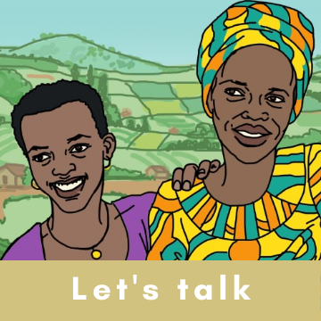
Intergenerational Dialogue: “Let’s Talk!” (“Reka Tuganire!”)
The resources model positive parenting and intergenerational relationships so parents and adolescents feel more comfortable talking with each other and peers about relationships and sexual and reproductive health and rights.
Episode 1 | Kayitesi chats with her husband, Karangwa, about how to communicate with their son, David, with care rather than anger.
Episode 3 | Cynthia's parents express concern about her choice of friends, listen and learn, and give her good advice on how to choose good friends.
Episode 2 | Cynthia talks with her mom, Kamariza, about being a teenager. They both realise they can speak openly with each other about ASRHR issues.

Slide 7
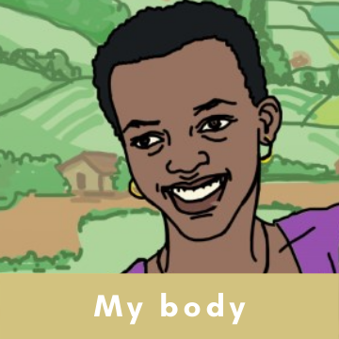
Puberty and Sexual Health: “My Body” (“Umubiri Wanjye”)
These resources teach young people about body changes, how to respect their own bodies and others’, and how to prevent pregnancy and sexually transmitted diseases.
Episode 1 | Keza realises that her classmate, Ganza, is just interested in touching her up, so she communicates her boundaries.
Episode 3 | Ganza finds out his girlfriend is pregnant and plans to ditch her. His friend, Cynthia, tells him he needs to own his responsibilities and prevent future pregnancies.
Episode 2 | Keza is overwhelmed by her body changes. Her friend, Cynthia, explains its normal and helps her to have self-love.
Additional Episodes
“Let’s Talk” Ep. 1
“My Relationships” Ep. 1

Slide 8
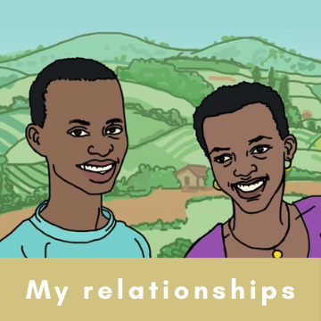
Love and Relationships: “My Relationships” (“Imibanire Yanjye”)
These resources teach young people and caregivers what healthy relationships look like. They also model how adolescents can make good relationship choices and protect themselves from abuse.
Episode 1 | Kayitesi (mum) talks with her daughter about Keza's questions. Mum promises to have frequent “talks” with Keza about ASRHR.
Episode 3 | Ritha talks with her younger friend, Cynthia, about the risks of having a sugar daddy.
Episode 2 | David gives his friend, Ganza, the low-down on porn. He explains that porn is not 'real' life and shows him that what he's doing is wrong.
Additional Episodes
“Let’s Talk” Ep. 1
“Let’s Talk” Ep. 2
“My Body” Ep. 1
“My Body” Ep. 3

Slide 9
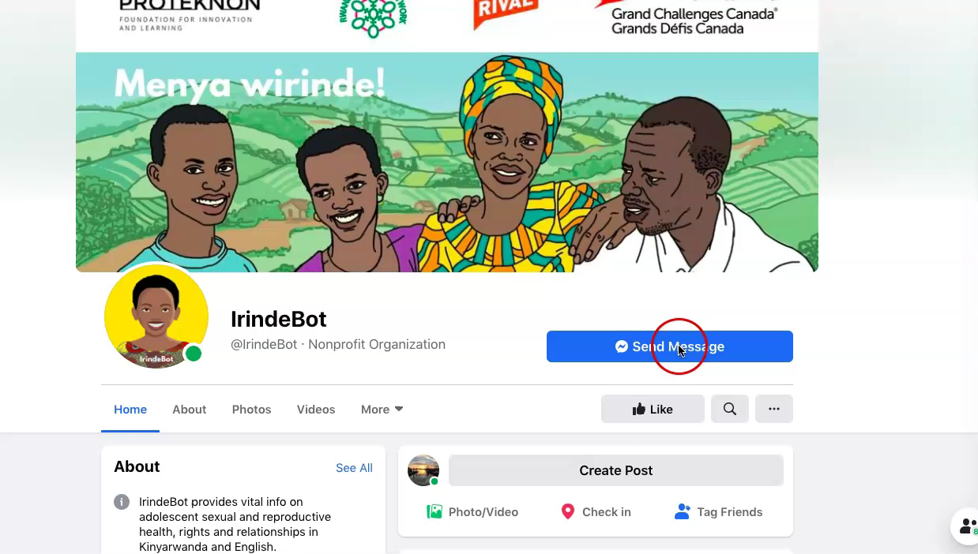
IrindeBot Facebook Page
Access the same content as on IrindeBot
Listen to the chatbot audio dramas
View over 80 posts in Kinyarwanda on relationships and sexual and reproductive health
The page remains active with the kind support of Rwanda Women’s Network.
Facebook Page
Audio Dramas & Videos
Images

Slide 10
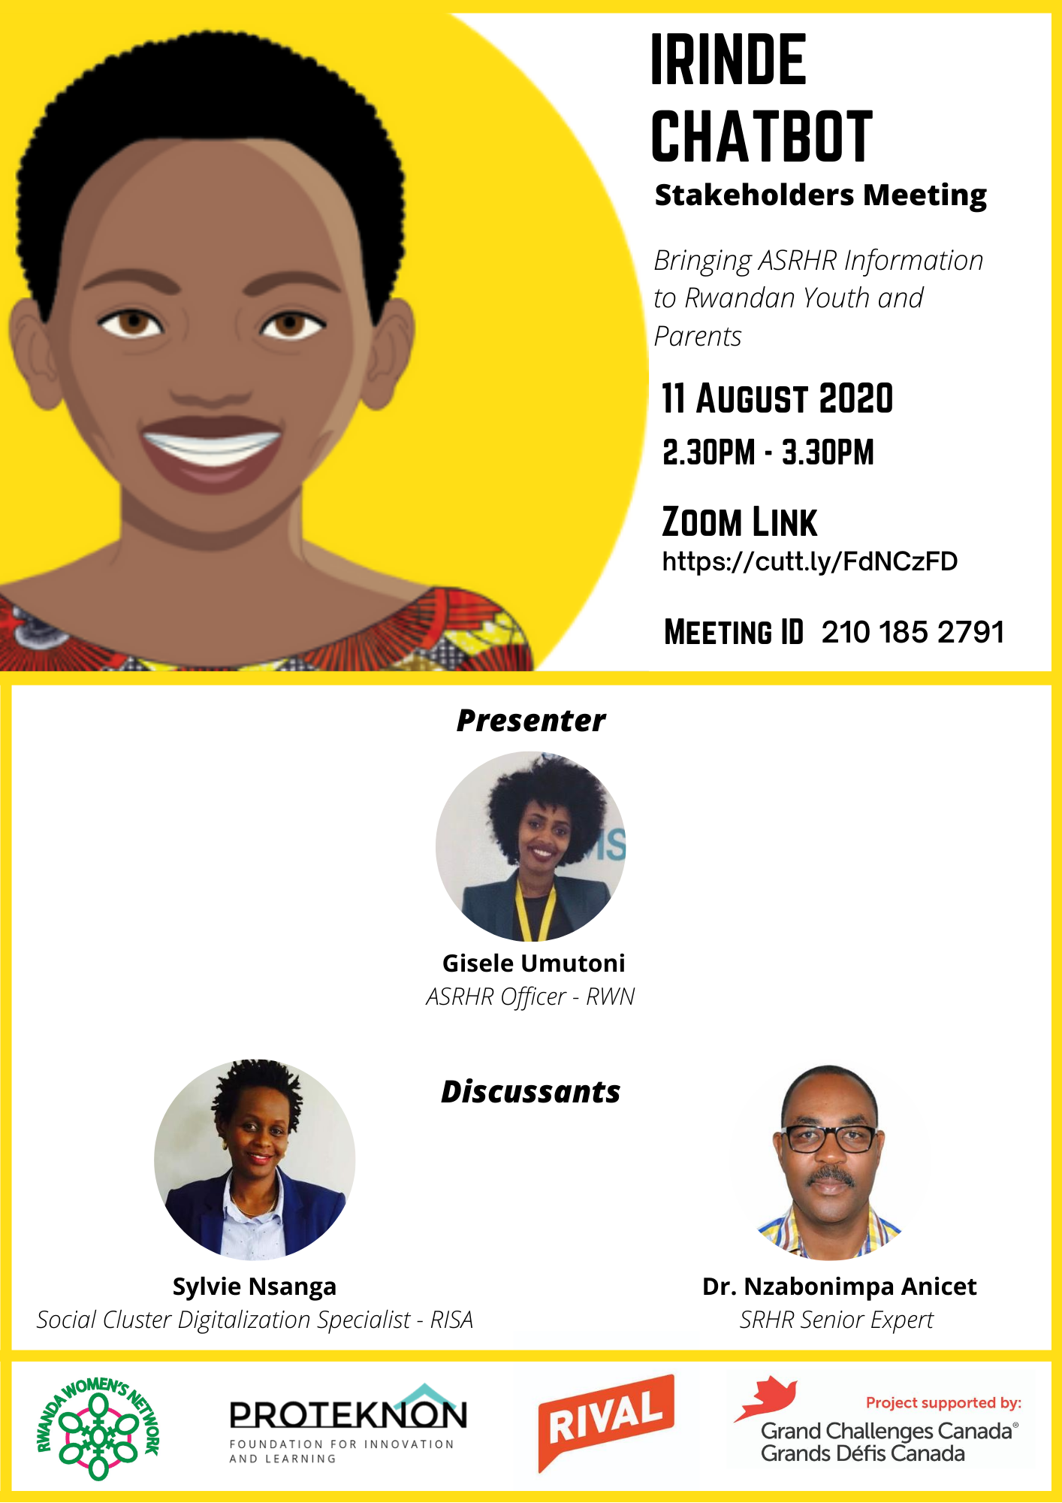
What are people saying?
The New Times News Decoder
“IRINDE taught me how to prevent unwanted/unplanned pregnancies and STIs” Male chatbot user
“It was very helpful. For me as a parent, it helped me learn about menstruation and how to give advice to my daughter about it. And also, that adolescent boys should be more careful since they can also impregnate girls if they are not cautious.” Female chatbot user
“This educational activity was designed for participants to take in multiple sittings. However, we learned quickly that most people preferred to complete the activity all at once. I think this speaks volumes to our conversational approach! It was rare that people would get bored and stop at our pause points, instead they remained engaged all the way through.” Rival Technologies

Slide 11
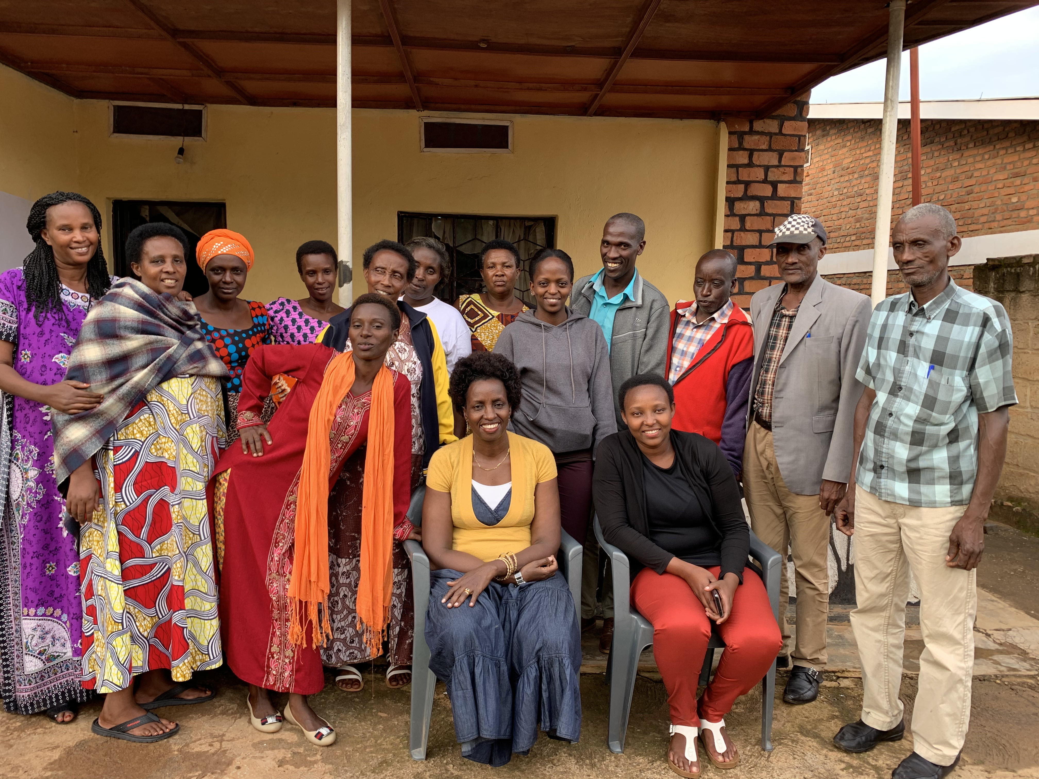
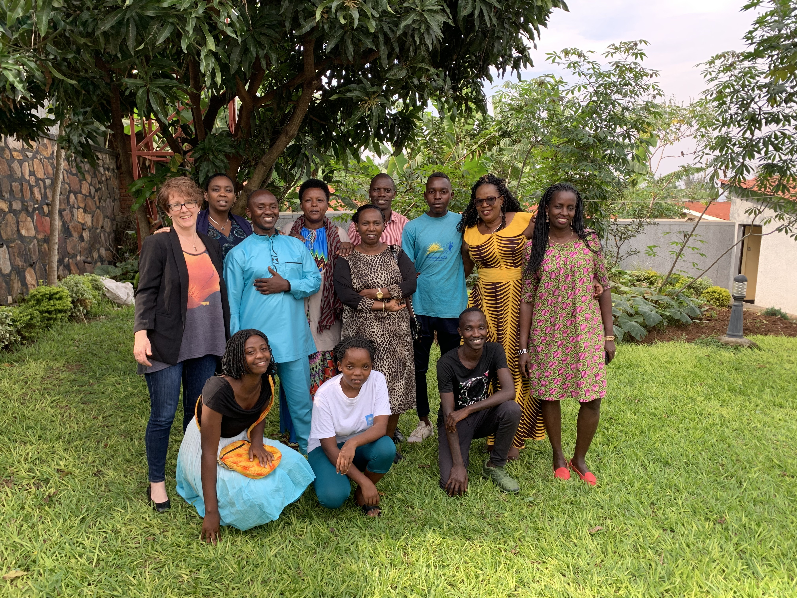
Much thanks to…
Our RWN youth and parent advisory teams, drama team, ASRHR advisory group, and the RWN board of directors
Our implementing partner, RWN, the teams at Rival Technologies and Proteknôn, and our funder, Grand Challenges Canada
“Behaviour change takes a coordinated and sustained effort by all stakeholders, from adolescents to community-based organisations, government and donors. To achieve gains in adolescent sexual and reproductive health in Rwanda, we all have to work together!” Project Lead, Kirsten Pontalti

Slide 12
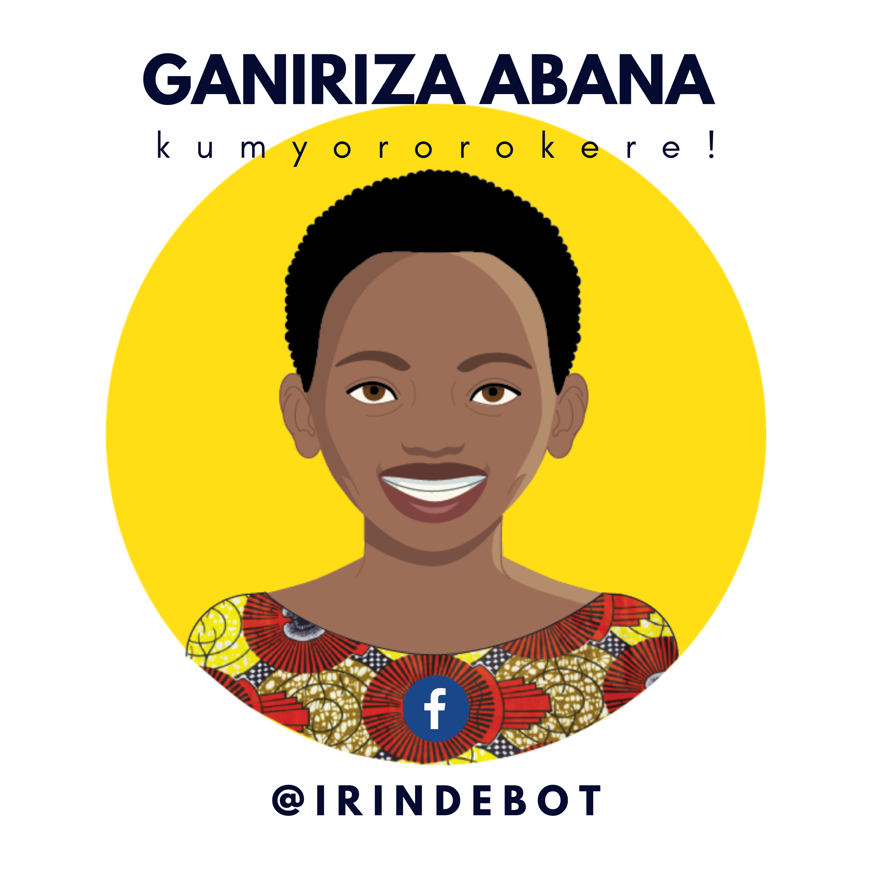
For more information…
Contact the Proteknôn Foundation or the Rwanda Women’s Network
These resource are open access. They may be used and replicated without permission for non-commercial purpose. When replicating, please credit Proteknôn Foundation for Innovation and Learning 2020. If you would like permission for commercial use, contact info@proteknon.net
Notes:
irinde@proteknon.net

